Slide 1
Transportation-44
Application for Advanced Transportation Technology Endorsement
[ Applicant : ROSIGN CO., LTD]

Slide 2
Novelty
1
Advancement
2
Economic Efficiency
3
* Q&A
☞

Slide 3
Novelty
1

Slide 4
1
_1) Damage Protection Technology in Case of Exposing Thermochromic Pigment to UV Rays
Test
Method
1 Cycle UV Exposure for 1 hour Index 10
Replicated 300 Cycle Experiment
(Table 6) Thermochromic Pigment Lifetime Test Comparing Existing Technology with Proposed Technology
Test Item | Test Description | Test Result | Note
UV Exposure Test | Sample : 300 * 300 * 300㎜ Thermochromic pigment with a range of temperatures: Blue at 5℃
 | Existing Technology | 5 Cycle | Not applicable to external environment
 | Proposed Technology | 300 Cycle | Applicable to external environment
Develop Mixing Technology for UV Protection
Novelty + Progressiveness

Slide 5
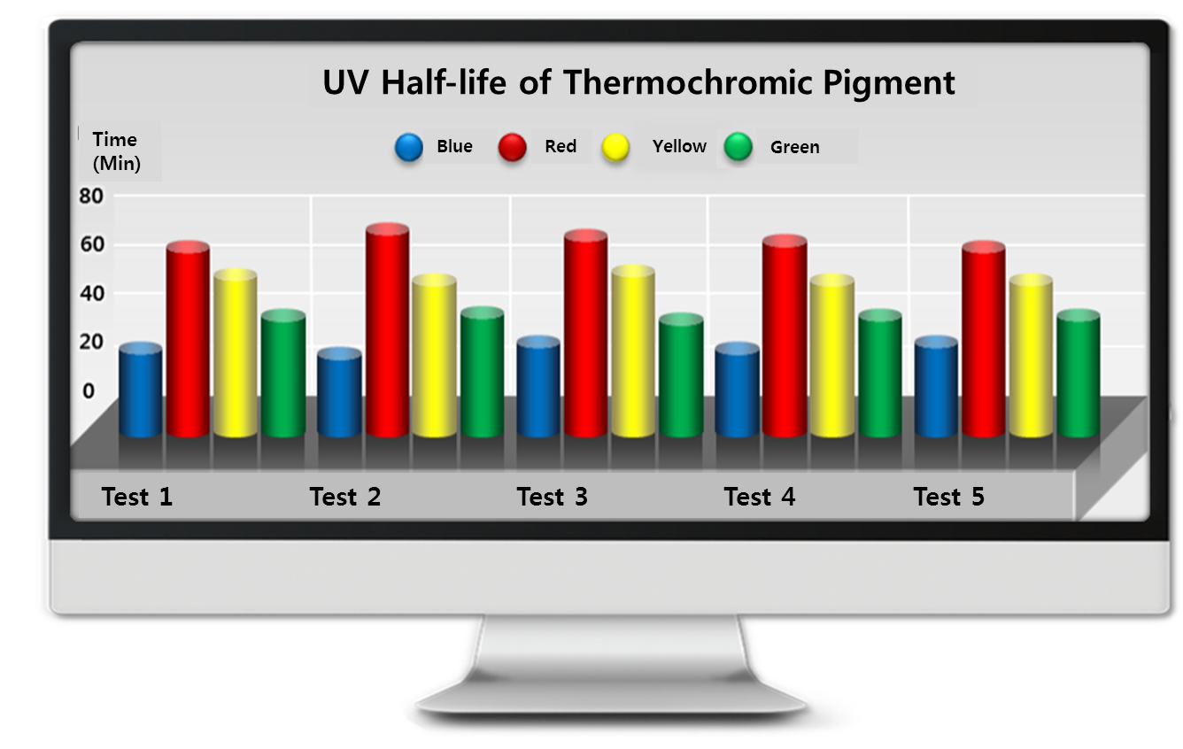
1
_2) Damage Protection Technology in Case of Exposing Thermochromic Pigment to UV Rays
Thermochromic Pigment Tolerance Test
Expose thermochromic pigment to UV for testing tolerance by color
Test
Method
(Graph 2) UV Tolerance by Color-coded Thermochromic Pigment

Slide 6
1
_3) Functions and Conclusion
Functions of Proposed Technology
Excellent chemical resistance, water resistance, bond strength,
adhesiveness
Blocking radiant heat & Reducing urban heat island effect
Visualization of icy roads
Easy to maintain
1
2
3
4
5
6
7
Different colors with a different range of temperatures
Enhanced durability and lifespan of the paved body and paving materials
Feasible to make roads with various designs

Slide 7
Advancement
2

Slide 8
2
_1) Eco-friendly Paving Materials due to Improvement of MMA Resin Binder
Heavy metals or carcinogenic substance such as epoxy, polyester, polyamino during and after curing processes
Improve Eco-friendly
MMA Resin
Necessary to improve MMA resin binder
Excerpts of Test Report
submitted to
Public Procurement
Service
(Table 12) Test of the Heavy Metal Content in Proposed Technology
Test Item | Measure | Test Result | Test Method
Plumbum(Pb)(Upper, Middle, Lower) | mg/kg | Non-Detection (Detection Limit 5) | KS M ISO 3856-1 : 2007
Cadmium(Cd)(Upper, Middle, Lower) | mg/kg | Non-Detection (Detection Limit 5) | KS M ISO 3856-4 : 2007
Hexavalent chromium(Cr6+)(Upper, Middle, Lower) | mg/kg | Non-Detection (Detection Limit 1) | KS M ISO 3856-5 : 2007
Hydrargyrum(Hg)(Upper, Middle, Lower) | mg/kg | Non-Detection (Detection Limit 2) | KS M ISO 3856-7 : 2007

Slide 9
2
_2) UV, Heat, Infrared Light Protection
① Enhance Paving Materials Durability by Protecting UV, Heat, Infrared Light
1 CYCLE -5℃~80℃
Replicated 150 CYCLE to induce deformation and checked the results
Test
Method
The Excellence of
Proposed Technology
Durability and lifespan of
the paved body and paving materials are highly
affected by temperatures.
(Table 9) Thermal Resistance Test Comparing Average Pavement and Proposed Technology
Test Item | Test Description | Test Result | Note
Thermal Resistance Test | Sample : 300 * 300 * 300㎜
 | Average Pavement | 40 CYCLE deformation | Easily deformed
 | Proposed Technology | 139 CYCLE deformation | Not much deformed

Slide 10
2
_3) UV, Heat, Infrared Light Protection
② Blocking Radiant Heat, the cause of heat island effect
(Graph 4) Measurement of Blocking Heat Comparing Average Pavement and Proposed Technology
Temperature
Average Pavement
Proposed Technology
[Temperature]
[Time]

Slide 11
2
_3) UV, Heat, Infrared Light Protection
35% UP
Proposed
Technology
90%
19% UP
Proposed
Technology
89%
Existing
Technology
55%
Existing
Technology
70%
[Blocking rate %]
UV
Heat(Infrared Light)
(Graph 3) UV, Heat, Infrared Light Blocking Rate

Slide 12
2
_3) UV, Heat, Infrared Light Protection
Excerpts of Test Report
submitted to
Public Procurement
Service
(Table 10) Test Results of Thermal Barrier Function and Thermal Insulation Effect
Test Item | Test Method | Test Result
Thermal Barrier Function | Check the temperature differences of inside and outside of samples (Temperature range: 0~50℃)
 | Sample : 300 * 300 * 300㎜ T-5㎜
 | Asphalt Concrete Pavement | About 1℃
 | Existing Non-slip Pavement | 2~3℃
 | Proposed Non-slip Pavement | 13~18℃
Thermal Insulation Effect | Expose samples to sunlight for 1 hour and check the surface temperature
 | Sample : 300 * 300* 50㎜
 | Asphalt Concrete Pavement | 57.5℃
 | Existing Non-slip Pavement | 50.8℃
 | Proposed Non-slip Pavement | 35.5℃

Slide 13
2
_4) Functional Advances and Conclusion
Functional Advances
Address cause of heat island effect
by blocking and controlling
radiant heat
Present colors and words
to see icy roads with the naked eye
Changed from vehicle highway to versatile road
Enhance durability and lifespan of the paved body and paving materials
by protecting UV, heat, infrared light
(Table 11) Life Cycle Cost Comparison between Prior Technology and Proposed Technology
Number | Name | Standard | Measure | Cost | Note
1 | Chamel Road Non-slip Pavement | Ascon & Concrete | ㎡ | 57,374 Won | Proposed Technology
2 | Rescon W Non-slip Pavement | Ascon & Concrete | ㎡ | 74,587 Won | Prior Technology

Slide 14
Economic Efficiency
3

Slide 15
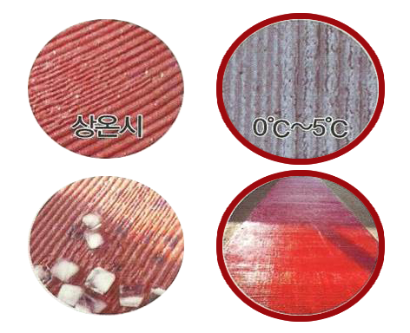
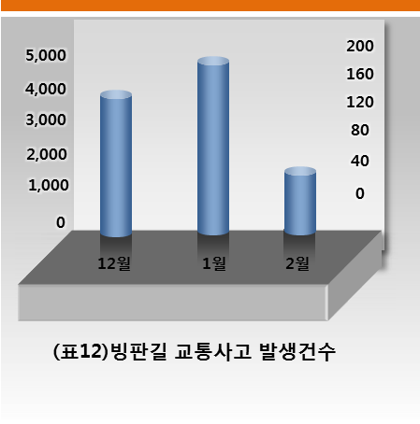
3
_1) Safety Measures by Visualizing Freezing Temperature
Present different colors and words in case of reaching freezing temperature
Maximize slip resistance by installing rumble strips
Roads with proposed technology – Reducing wear rate and using safe roads
Room
temperature
(Table 12)The number of traffic accidents on icy roads
(Picture 1) Principles of Proposed Technology and Product Pictures

Slide 16
3
_2) Safety Measures by Visualizing Freezing Temperature
Test Results of Wear Rate and Slip Resistance(BPN)
(Table 13) Proposed Technology Test Result of Wear Rate
Test Item |  | Test Result | Test Method | Note
Abrasion Loss(mg) | First time | 98 | KS F 2813-2001 | Test result in 2009
 | Second time | 82
Abrasion Resistance(mg) (CS-17, 1000g, 1000회) |  | 106 | KS F 2813-2001 | Test result in 2012
Test Agency: Korea Conformity Laboratories
(Table 14) Proposed Technology Test Result of Slip Resistance
Test Item | Test Result | Test Method | Note
Slip Resistance(BPN) | 62 | KS F 2375 : 2001 | Test result in 2009
Slip Resistance(BPN) | 72 | KS F 2375 : 2001 | Test result in 2011
Slip Resistance(BPN) | 78 | KS F 2375 : 2001 | Test result in 2012
Test Agency: Korea Conformity Laboratories

Slide 17
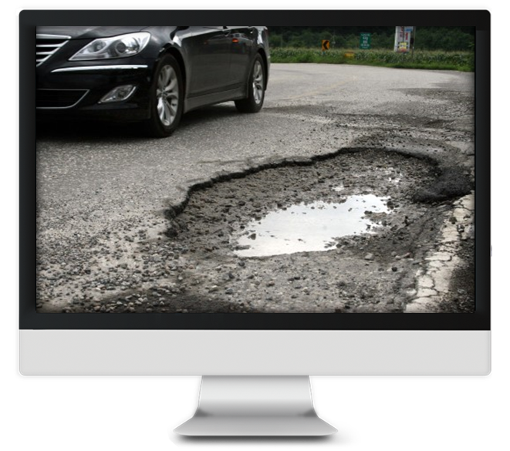
3
_3) Reducing Defect Rate of Paving Materials by protecting UV, Heat, Infrared Light
Elimination of the paved body and paving materials leads to road pollution
Increasing vehicle damage and the danger of accident
Roads with proposed technology -
Reducing defect rate, enhancing durability and lifespan and using safe roads
(Photo 1) The Pothole of Paving Materials

Slide 18
3
_3) Reducing Defect Rate of Paving Materials by protecting UV, Heat, Infrared Light
Adhesive Strength and Accelerated Weathering Resistance
(Table 15) Summary of Test Results on Proposed Technology Adhesive Strength
Test Item | Test Result | Test Method | Note
Adhesive Strength -after standard curing(N/㎟) | 2.0 | KS F 4936 : 2008 | Exceed standard of KCL
Adhesive Strength -after cycles of freezing and thawing(N/㎟) | 1.7 | KS F 4936 : 2008 | Exceed standard of KCL
Test Agency: Korea Conformity Laboratories
(Table 16) Summary of Test Results on Proposed Technology Accelerated Weathering Resistance
Test Item | Test Result | Test Method | Note
Accelerated Weathering Resistance (Appearance- discolor, small cracks) Open frame- Carbon arc 200 hours | No damage | KS M 5000(3231):2009 | The first test result in 2009
Accelerated Weathering Resistance (Appearance- discolor, small cracks) Open frame- Carbon arc 200 hours | No damage | KS M 5000(3231):2009 | The second test result in 2009
After Accelerated Weathering Resistance Test (WS, 300 hours) -Appearance(cracking, blistering, falling) | No damage | KS F 2274:2007 | Test result in 2012
After Accelerated Weathering Resistance Test (WS, 300 hours) -Color difference | 1.7 | KS F 2274:2007 KS M ISO 7724-2:2007 | Test result in 2012
Test Agency: Korea Conformity Laboratories

Slide 19
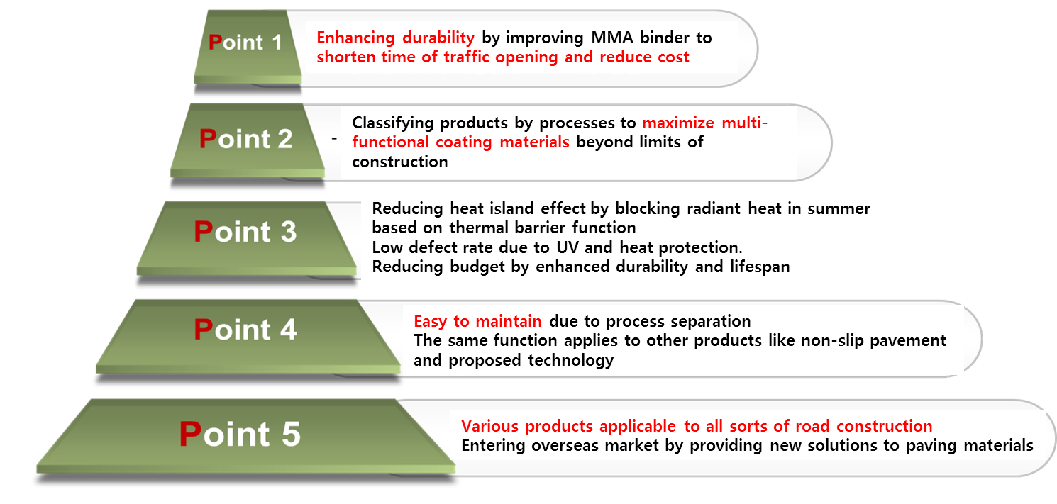
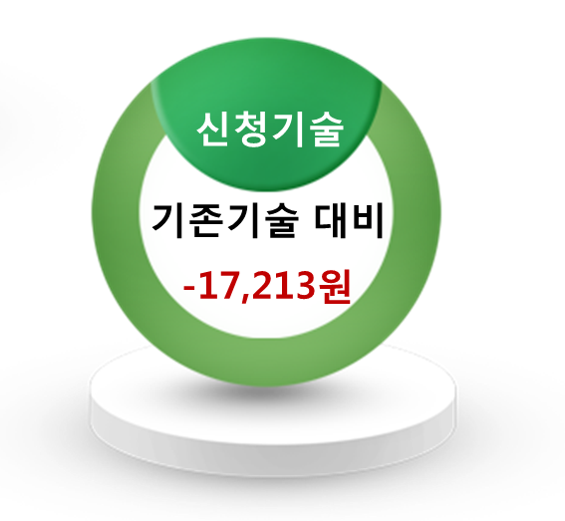
3
_7) Economic Efficiency and Conclusion
Comparing
existing products
32,643 won/each
29.57%
Cost Reduction
Proposed Technology
Against
Existing Technology
(Table 11) Life Cycle Cost Comparison between Prior Technology and Proposed Technology
Number | Name | Standard | Measure | Cost | Note
1 | Chamel Road Non-slip Pavement | Ascon & Concrete | ㎡ | 57,374 Won | Proposed Technology
2 | Rescon W Non-slip Pavement | Ascon & Concrete | ㎡ | 74,587 Won | Prior Technology

Slide 20
Thank you
ROSIGN
Address : 404 Seokcheon Bldg., 28, Nonhyeon-ro 26-gil, Gangnam-gu, Seoul, South Korea Tel. 02-554-0148. Fax. 02-585-0148
COPYRIGHT© ROSIGN. All Right Reserved

Slide 21
* Q&A
☞

Slide 22
☞
_1)The Solar Spectrum
* The Solar Spectrum
UV Light
(3%)
Visible Light
(47%)
Infrared Light
(50%)
100
근적외선 (780~2100nm) 영역
Proposed Technology
80
60
40
20
General Road
Reflectivity
(%)
Wave
Length
(nm)
0
350
360
850
1100
1350
1600
1850
2100

Slide 23
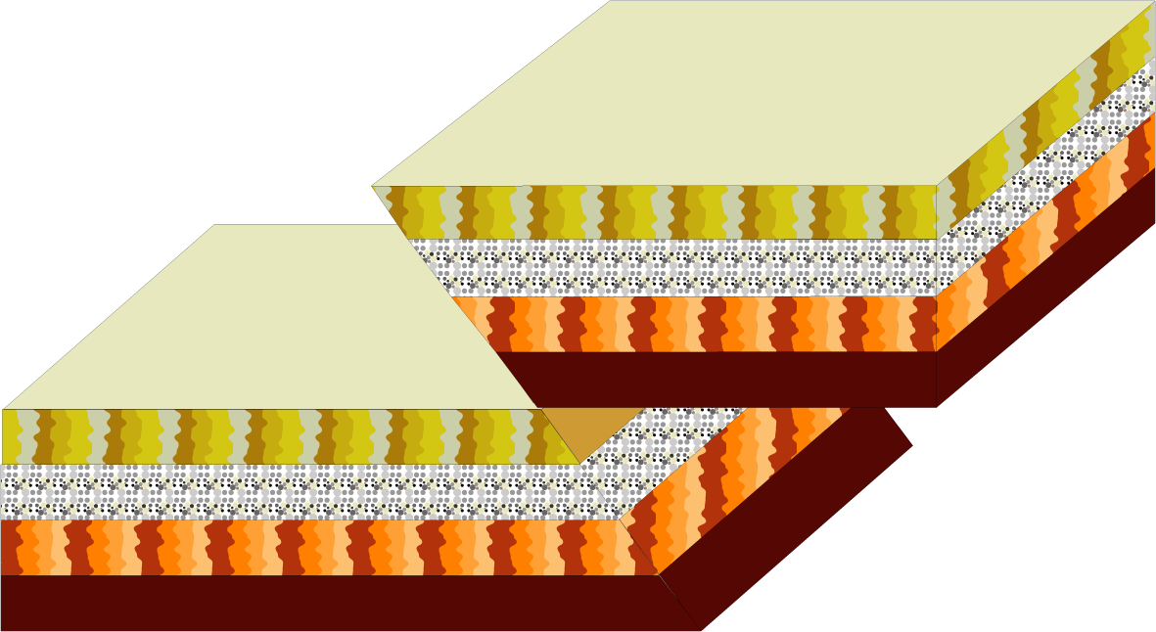
☞
_2) Cross Sections of Surfaces
Solar Light
Ceramic Particles
Insulation Paint
Solar Light
Reflection
* Thermal Insulation Coating Materials
< Cross sections of surfaces>

Slide 24
☞
_3) The Color Scheme of Products
YJC T-01(Red)
YJC T-02(Green)
YJC T-03(Yellow-green)
YJC T-04(Blue)
YJC T-10(Sky-blue)
YJC T-06(Yellow)
YJC T-07(Orange)
YJC T-08(Red brown)
YJC T-09(Pink)
YJC T-10(Violet)

Slide 25
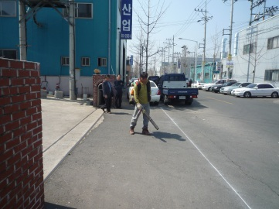
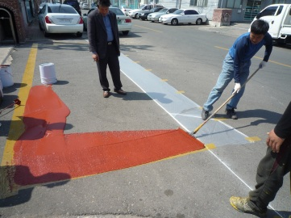
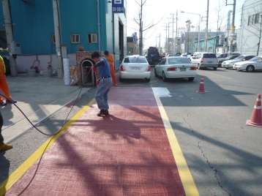
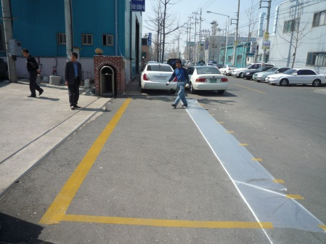
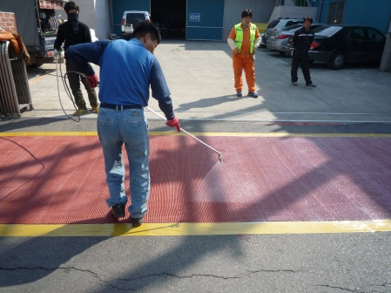
☞
_4) Construction Sequences
Step7
Step2
Step4
Step5
Step6
Step1
Step3
Room
temperature
Prepare construction∙
Traffic control∙Cleaning
Agitation∙Distribution∙Spraying
Clean up taping and surroundings
Complete construction and ice test
Curing, Inspection & Check
Mark the areas and taping
Coating middle∙upper areas

Slide 26
☞
_5) Data on Self-test
* Table of Self-test data
Criteria | Principle Standard | Test Result of Proposed Technology | Note
Test results criterion Local government average test results criterion -measurement condition- - ISO 9050 - KSL 2514 : D65/2 - KSL 2016 : A/2 | Visible light transmittance over 44% | 84%
 | Visible light reflectivity below 18% | 9%
 | UV blocking ratio over 96% | 98.7%
 | Infrared light blocking ratio over 94% (1,000 nm) | 96%
 | Gross energy transmittance below 49% | 19%
 | Thermal transmittance below 5.6(W/㎡K) | 2.8
 | Screen coefficient below 0.67 | 0.34
 | Solar energy reflectivity(exterior) below 12% | 9%

Slide 27
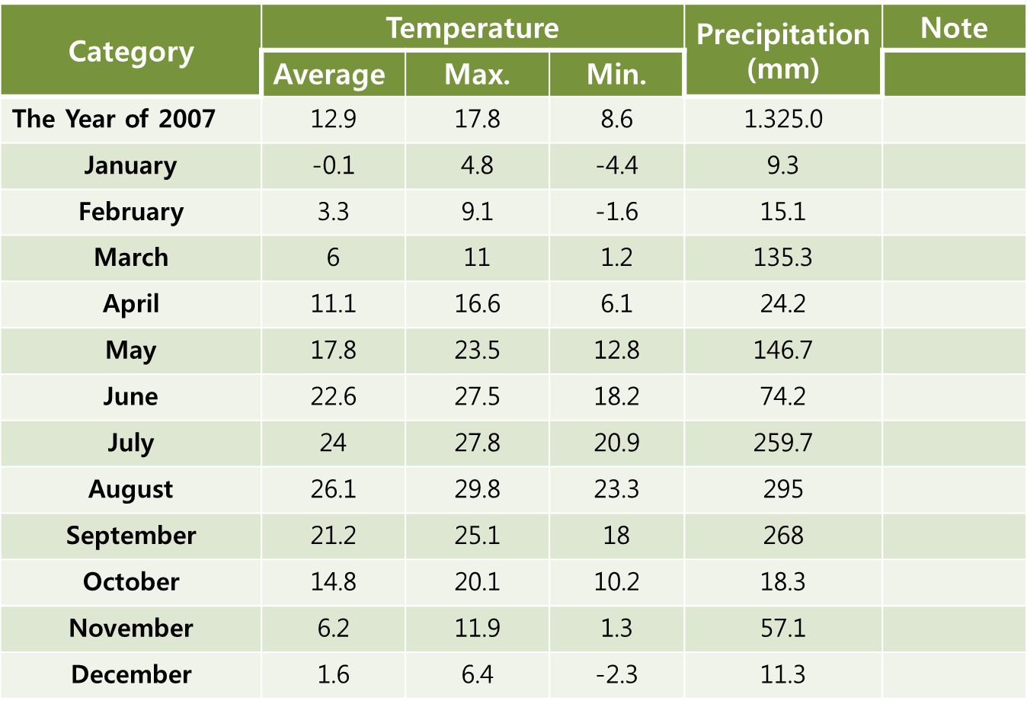
☞
_6) Table of Climate Condition
* Table of climate condition
[ Suwon Weather Station, January 1st, 2008 ]

Slide 28
☞
_9) Public Interest
1
2
3
The dissemination of proposed technology helps overcome existing technology limits and enable to design roads in accordance with road alignments which have become. intelligent
All sorts of accidents on the roads can be prevented in advance and reduce great loss caused by social costs and casualties.
Radiant heat in summer can be blocked, reducing paving materials and maintenance costs and cutting socioeconomic cost.
Public
Traffic safety
Ttraffic safety
Public
Interest

Slide 29
☞
_10) Possibility of Market Formation
1
2
3
The government and local governments order more than 70% of colored paving materials.
Urgent to introduce intelligent paving materials to ensure users’ safety
- Meet the needs of proposed technology market
Possibility
Traffic safety
Ttraffic safety
Possibility of Market Formation
4 trillion won
by Korean standards
Main purpose of proposed technology

Slide 30
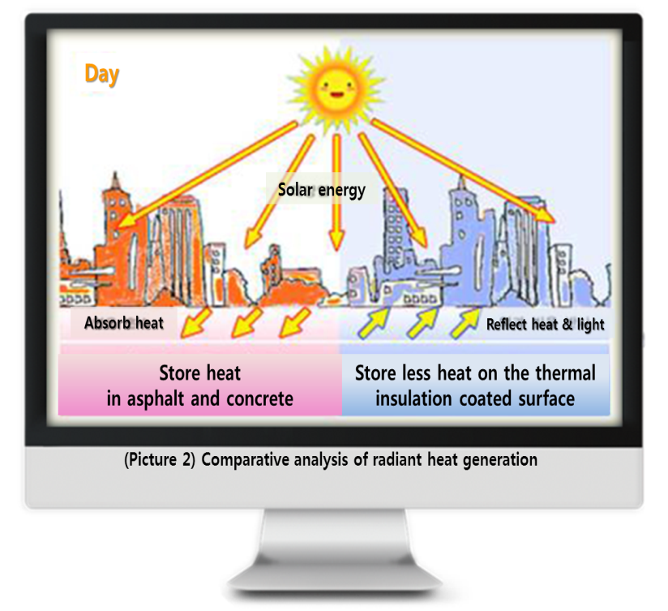
☞
_11) The Need for Dissemination
1
2
3
Preventing accidents
on the icy roads
& safety accidents
Dissemination
Traffic safety
Ttraffic safety
The Need for Dissemination
Enhancing durability of
paving materials
Reducing heat island effect
caused by radiant heat

Slide 31
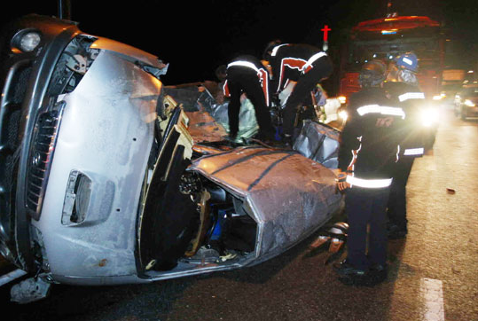
※
_The Scene of the Accident in November 27th, 2013
“Proposed technology can prevent traffic accidents in advance because drivers are able to identify road condition ahead of time.”
“The snow that fell throughout the day froze as the temperature dropped, causing traffic accidents.”
“40-vehicle crash in Gamayukkyo Mipyeong-dong, Hengdeok-gu, Cheongju-si, Chugcheongbuk-do on the 27th of November at 18: 40.”
The Chosun Ilbo, 2013.11.28
“A series of traffic accidents occurred on snowy roads in Chungcheong and Gangwon areas where heavy snow fell.”
“40-vehicle∙20-vehicle crashes in Cheongju…
A 10-car pileup also happened in Daejeon.”
“A starex van crossed a median strip, crashed into the rear-end of a 5-ton-truck and caused a head-on collision with the following intercity bus, killing 6 people in the van.”
(Photo) The scene of pileup involving 40 vehicles in Cheongju
The Dong-A Ilbo, 2013.11.28

