Slide 1



ROAD SAFETY AUDIT (rsa)

Slide 2
Road traffic deaths: the facts
1.3 million deaths
20-50 million injured
2
1
0

1.8


1.3
1.3
Million people

<1
AIDS-related deaths
UNAIDS 2008
Tuberculosis
WHO 2007
Road traffic
WHO 2004
Malaria
WHO 2008
Source: WHO (World Health Organization)

Slide 3
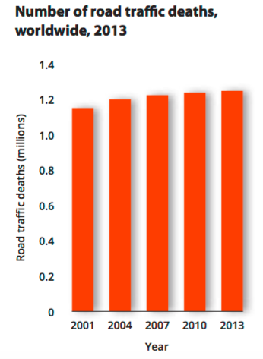
Road safety in the world (1/3)
1.25 million road traffic deaths globally in 2013 – a figure that has increased since 2007
This increase must be seen against the backdrop of global population growth and motorization. The population increase of 4% between 2010 and 2013 and an increase of 16% in registered vehicles over the same period suggests that efforts to slow the increase in road traffic deaths may have prevented deaths that would otherwise have occurred.
Source: WHO (World Health Organization)

Slide 4
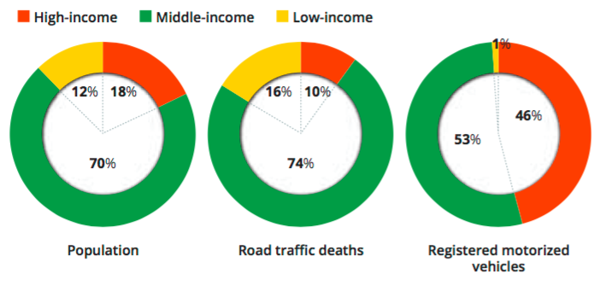
Road safety in the world (2/3)
Low- and middle-income countries bear a disproportionate burden of road traffic deaths
90% of road traffic deaths occur in low- and middle-income countries, and while these countries also account for 82% of the world’s population, they nevertheless bear a disproportionate number of deaths relative to their level of motorization, as they account for only 54% of the world’s registered vehicles
Source: WHO (World Health Organization)

Slide 5
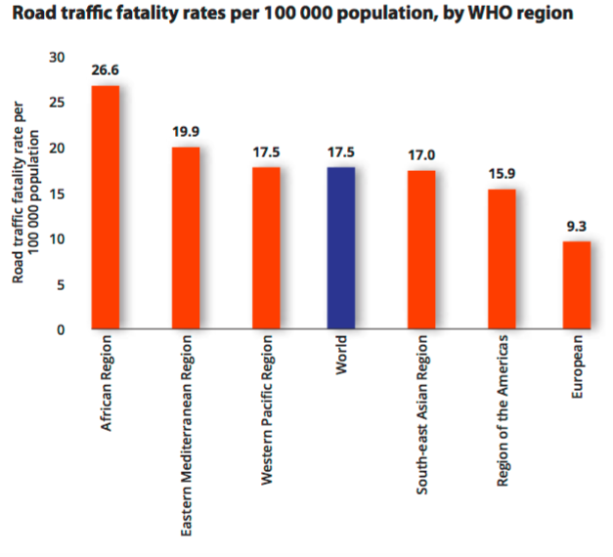
Road safety in the world (3/3)
The risk of a road traffic death is highest in the African Region
The Eastern Mediterranean Region is the only region where high- income countries have a higher road traffic death rate than low- or middle-income countries
18.9
Russian Federation
Source: WHO (World Health Organization)

Slide 6
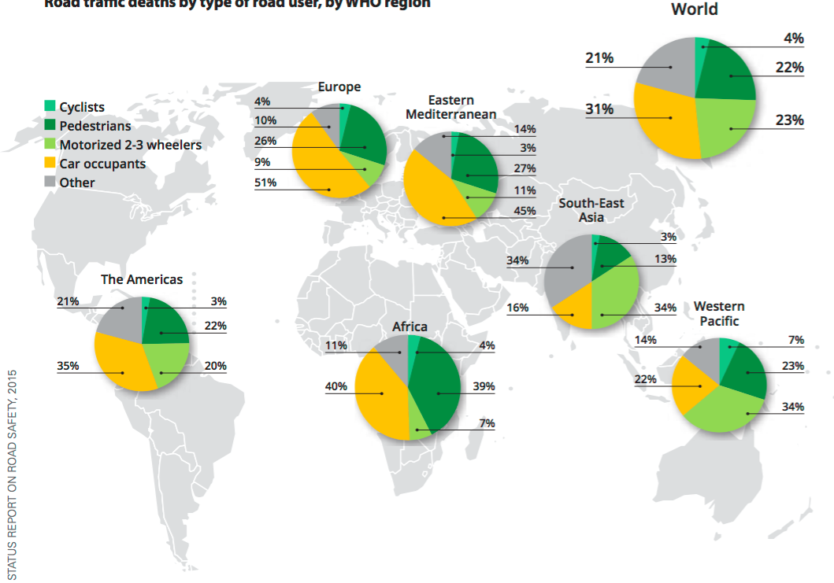
ROAD TRAFFIC DEATHS BY TYPE OF ROAD USER, BY WHO REGION
… road traffic deaths among pedestrians, cyclists and motorcyclists are intolerably high
Source: WHO (World Health Organization)

Slide 7
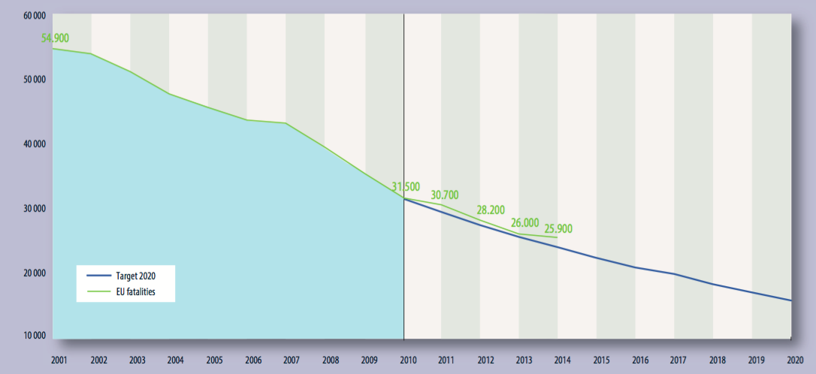
Road safety in Europe
Fatalities
Source: European Commission

Slide 8
What to do?
Road traffic injuries will become the 5th cause of mortality by
2030 if nothing is done
2004
2030
Rank | Disease or Injury
1 | Ischaemic heart disease
2 | Cerebrovascular disease
3 | Lower respiratory infections
4 | COPD
5 | Diarrhoeal diseases
6 | HIV/AIDS
7 | Tuberculosis
8 | Trachea, bronchus, lung cancer
9 | Road traffic injuries
10 | Prematurity & low-birth weight
Rank | Disease or Injury
1 | Ischaemic heart disease
2 | Cerebrovascular disease
3 | COPD
4 | Lower respiratory infections
5 | Road traffic injuries
6 | Trachea, bronchus, lung cancer
7 | Diabetes mellitus
8 | Hypertensive heart disease
9 | Stomach cancer
10 | HIV/AIDS
Source: WHO (World Health Organization)

Slide 9

Decade of Action for Road Safety 2011-2020
United Nations General Assembly (2010)
Its goal is to stabilize and reduce the forecast level of road traffic deaths around the world.

Slide 10

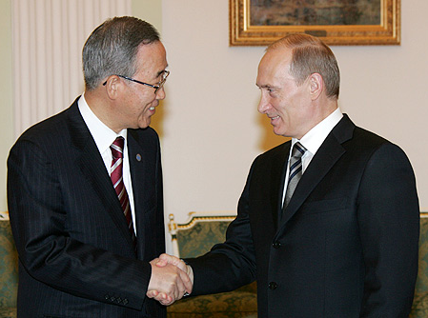
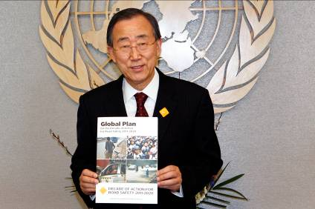
Decade of Action for Road Safety 2011-2020
United Nations General Assembly (2010)

Slide 11
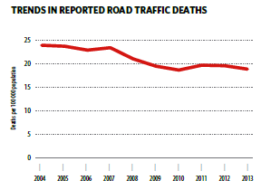

Decade of Action for Road Safety 2011-2020
United Nations General Assembly (2010)
Russian Federation

Slide 12
The European Directive 2008/96/EC
The Directive 2008/96/EC provides the basic rules on
road infrastructure safety management
Subject matter and scope (Article 1)
The Directive requires the establishment and implementation of procedures relating to:
The Directive shall apply to roads which are part of the trans-European road network, whether they are at the design stage, under construction or in operation.
Road safety impact assessments
Road safety audits
Management of road network safety
Safety inspections

Slide 13
The tools of the European Directive
Planning
Road safety impact assessment
Design and construction
Road safety audits (RSA)
Operation
Management of road network safety - Reaction (facts)
Safety inspections - Preventative
Design Characteristics;
Integral part of the design process;
Audit report;
Recommendations.
  Identification of road sections with a high accident concentration;
  Identification of sections for analysis in network safety ranking (potential savings);
  Site visit (Appropriate measures).
  Initial planning stage;
  Choices of proposed solutions;
  Cost-benefits analysis.

Slide 14

The role of the Auditor according to Dir. 2008/96/EC
Auditors undergo an initial training resulting in the award of a certificate of competence, and take part in periodic further training courses.
Auditors are appointed in compliance with the following requirements:
they have relevant experience or training in road design, road safety engineering and accident analysis
road safety audits are only undertaken by auditors or teams to which auditors belong, holding a certificate of competence
for the purpose of the infrastructure project audited, the auditor is not at the time of the audit be involved in the
conception or operation of the relevant
infrastructure project

Slide 15

Training of auditors (1/2)
International Road Federation
Policy Statement: Requirements for RSA Team Leaders
An unqualified road safety auditor could miss obvious safety concerns resulting in an unsafe road
Poorly performed or badly documented Road Safety Audits can have negative effects on safety
In order to ensure minimum qualification criteria are met, each country needs to establish a national certifying body or set accreditation standards for independent third party bodies, whether national or international, to train and certify road safety auditors

Slide 16
Benchmarking
Country | Professional requirements | Additional requirements | Duration of the training course
Denmark | 3 years as road safety engineer | Successfully pass a test in road safety knowledge | 3 days
United Kingdom | 4 years experience working in collision investigation or road safety engineering | 5 RSA during previous 12 months 10-day formal training in collision investigation and road safety engineering | 3 days
Sweden | 5 years experience in civil engineering | Formal training course for road safety auditors | 5 days
Ireland | Chartered engineer or equivalent with at least 2 years experience of collision investigation and remedial measures | 5 RSA during previous 3 years | 10 days
Italy | Engineer with at least 5 years experience |  | 180 hours (4 weeks)

Slide 17
The auditors
Education and experience:
The success of an audit depends on road safety skills, abilities and experience of the auditor
Road safety competence in audits comes through practical experience
Training is useful at first, but is only a basis on which the experience must be built

Slide 18
Road Safety Audit
“Independent detailed systematic and technical safety check relating to the design characteristics of a road infrastructure project and covering all stages from planning to early operation”
(Art. 2, Dir. 2008/96/EC)

Slide 19
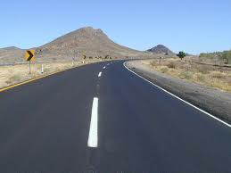
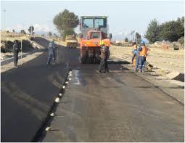
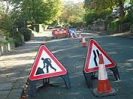
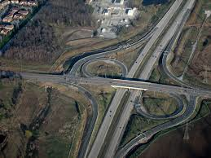
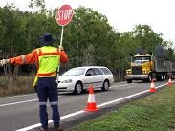

Which projects need to be audited?
ALL TYPES OF ROAD PROJECTS
significant temporary traffic management arrangements
Improvements and major maintenance of existing roads
Construction of
new roads
Reconstruction of interchanges and junctions
Major traffic management schemes
Development
schemes

Slide 20
Stages of Audit
Increasing attention to major issues
ROAD DEVELOPMENT PHASES
RSA STAGES
Reducing opportunities for changes
Pre Construction
Stage 1 – Preliminary Design
Stage 2 – Detailed Design
Construction
Stage 3 – Pre-Opening
Post Construction
Stage 4 – Post-Opening
RSAs can, and ideally should, be conducted at every stage in the life-cycle of a road project

Slide 21
Road Safety Audit process who does what?
ACTIVITY
RESPONSIBILITY
ACTIVITY
RESPONSIBILITY
1
Prepare and Issue
of the Audit Brief
Design Team
7
Undertaking the RSA
RSA Team
2
Commission the Audit
Client
8
Prepare of the RSA report
RSA Team
3
Collate information
Design Team Client
9
Completion Meeting
Client, Design Team, RSA Team
4
Client, Design Team, RSA Team
10
Commencement Meeting
Responding to the RSA report
Client,
Design Team
5
RSA Team
11
Information review
Design Arrangements
Client,
Design Team
6
RSA Team
12
Site Inspection
Filling and Archiving
Client

